Slide 1

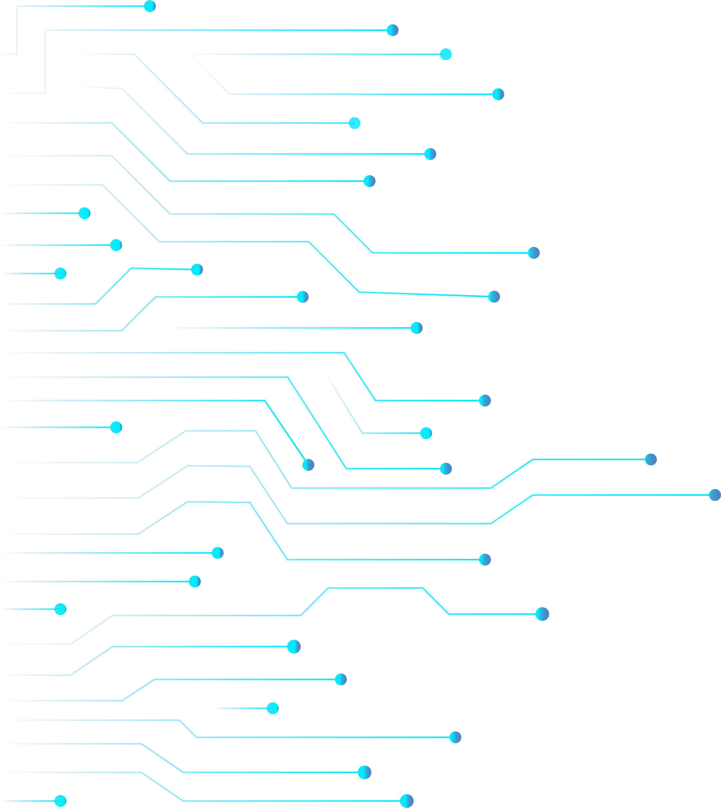
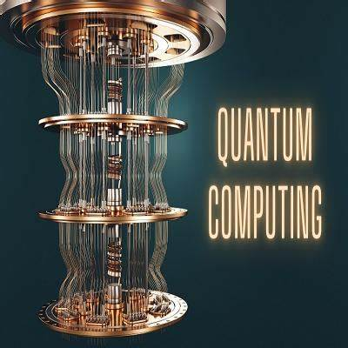
QUANTUM COMPUTING

Slide 2

What is QUANTUM COMPUTING ?
Quantum computing is an area of computer science that uses the principles of quantum theory. Quantum theory explains the behavior of energy and material on the atomic and subatomic levels.
Quantum computing uses subatomic particles, such as electrons or photons. Quantum computing has the capability to sift through huge numbers of possibilities and extract potential solutions to complex problems and challenges. Where classical computers store information as bits with either 0s or 1s, quantum computers use qubits

Slide 3

what is Quantum Computing
1
Quantum computers use quantum bits or qubits, which can exist in multiple states simultaneously due to superposition. Classical computers use classical bits that can only represent either 0 or 1.
2
Qubits can exist in a superposition of states, which means they can represent both 0 and 1 at the same time. This allows quantum computers to explore multiple possibilities in parallel.
3
Qubits can be entangled, meaning the state of one qubit is dependent on the state of another, regardless of the distance between them.
4
Quantum computers use quantum gates to manipulate qubits. These gates can perform operations on qubits in superposition, taking advantage of quantum properties to perform calculations.
5
Quantum computers use specialized quantum algorithms to solve certain problems more efficiently than classical algorithms.

Slide 4
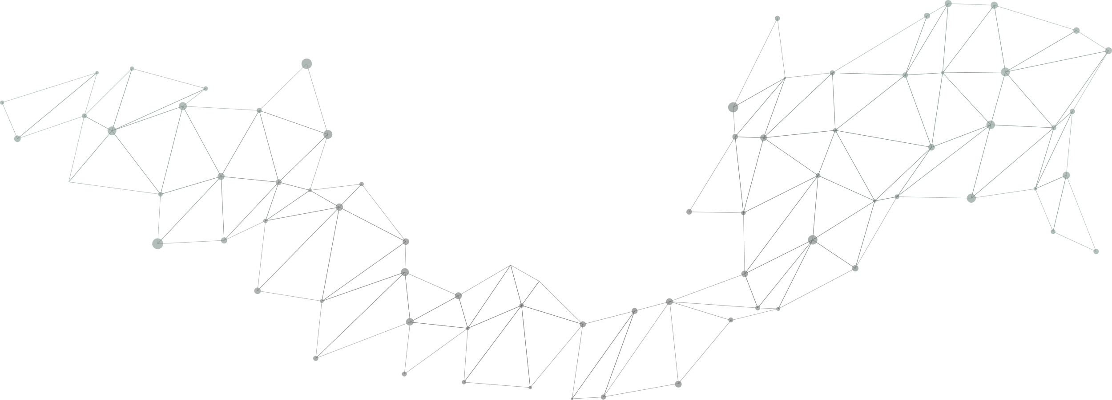

Features of Quantum Computing
SUPERPOSITION
ENTANGLEMENT
DECOHERENCE
EXPONENTIAL SPEEDUP
According to IBM, it's what a qubit can do rather than what it is that's remarkable. A qubit places the quantum information that it contains into a state superposition.
Entanglement it is integral to quantum computing power. Pairs of qubits can be made to become entangled. This means that the two qubits then exist in a single state.
Decoherence occurs when the quantum behavior of qubits decays. The quantum state can be disturbed instantly by vibrations temperature changes.
Quantum computers have the potential to provide exponential speedup for specific problems. For example, they can efficiently factor large numbers.

Slide 5
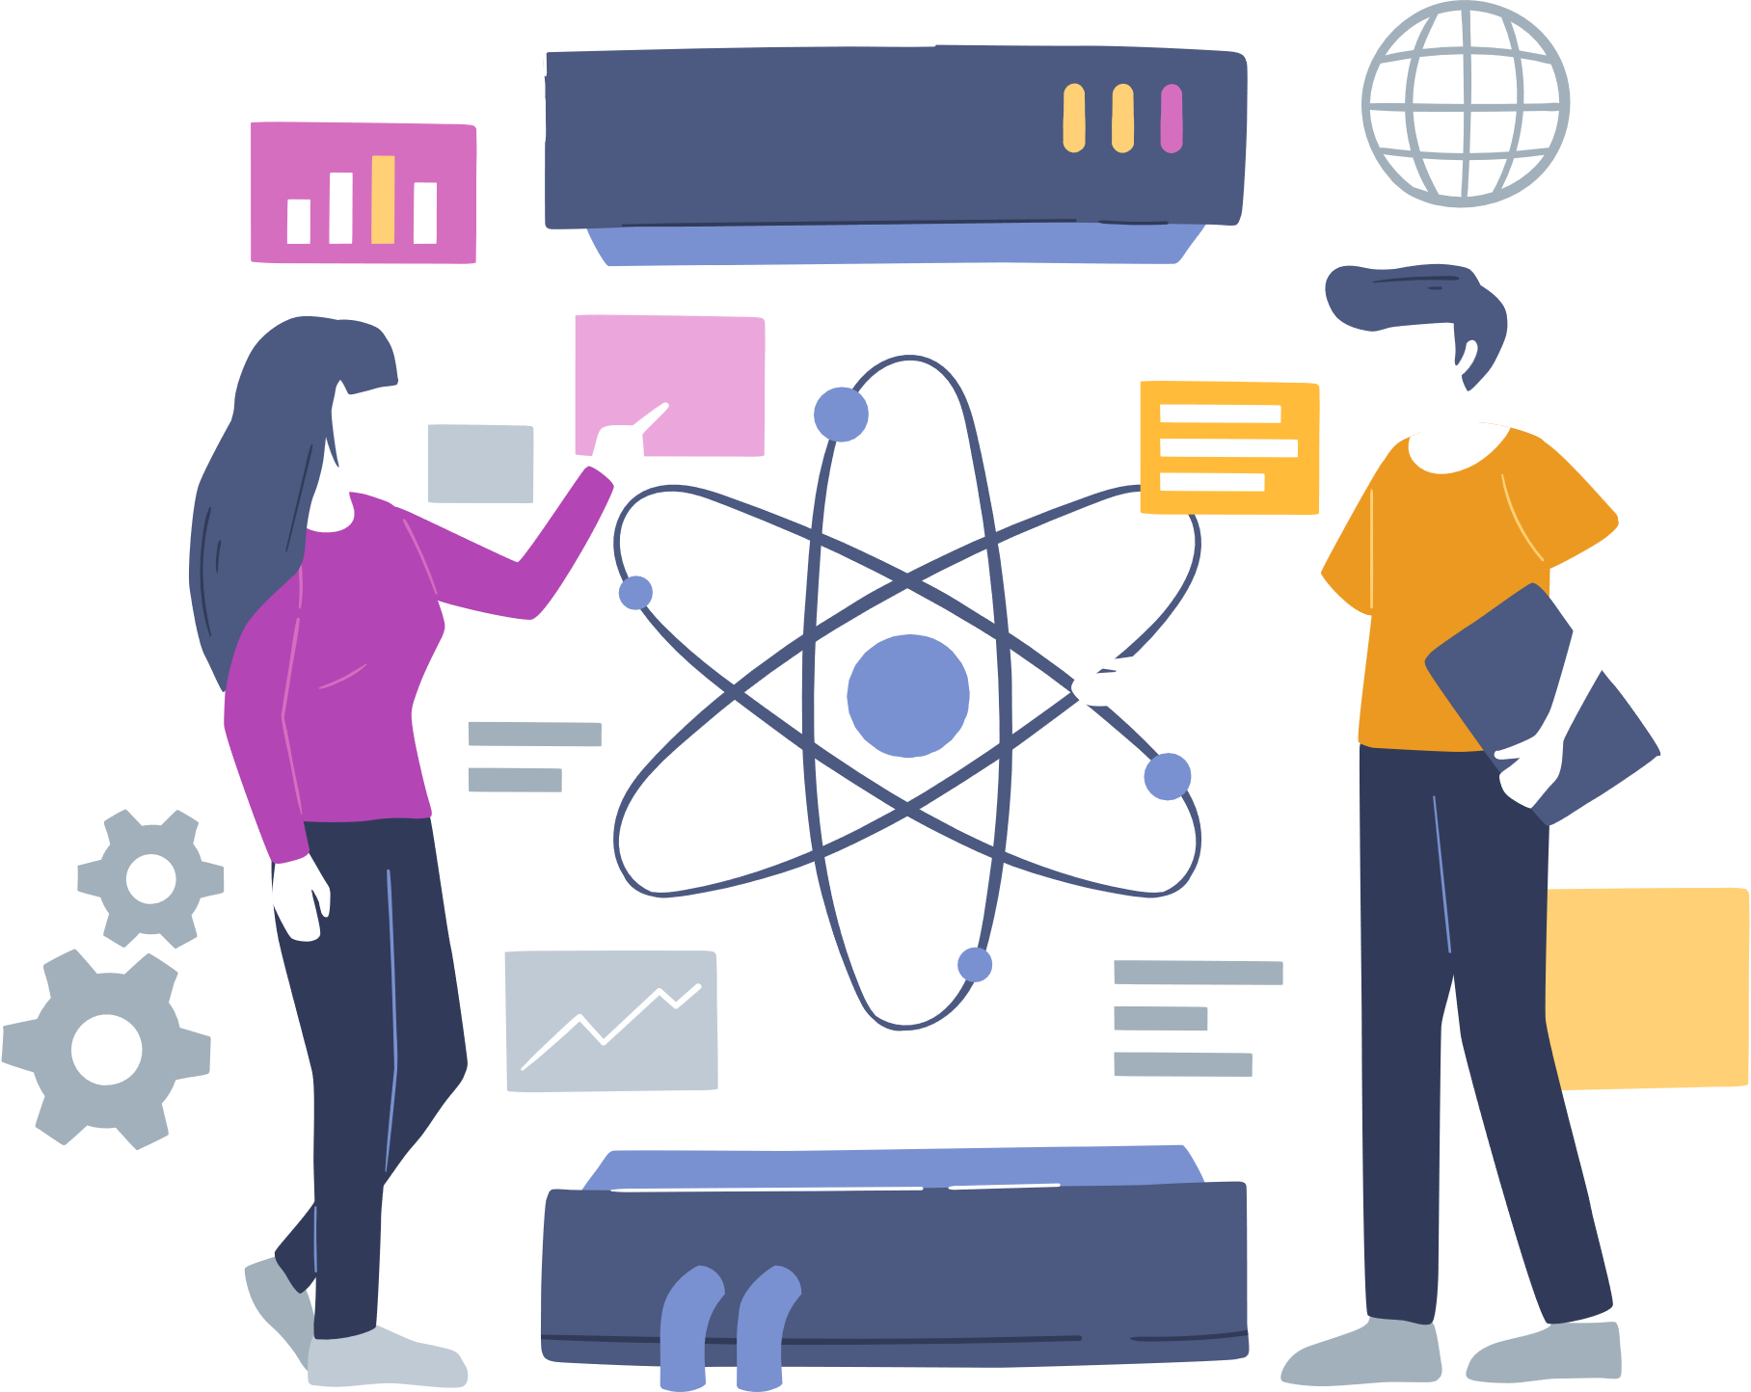

QUANTUM COMPUTERS IN DEVELOPMENT
1
GOOGLE is spending billions of dollars to build its quantum computer by 2029. The company opened a campus in California called Google AI to help it meet this goal.
2
IBM plans to have a 1,000-qubit quantum computer in place by 2023. For now, IBM allows access to its machines for those research organizations.
3
MICROSOFT offers companies access to quantum technology via the Azure Quantum platform.
4
OTHERS There’s interest in quantum computing and its technology from financial services firms such as JPMorgan Chase and Visa.

Slide 6

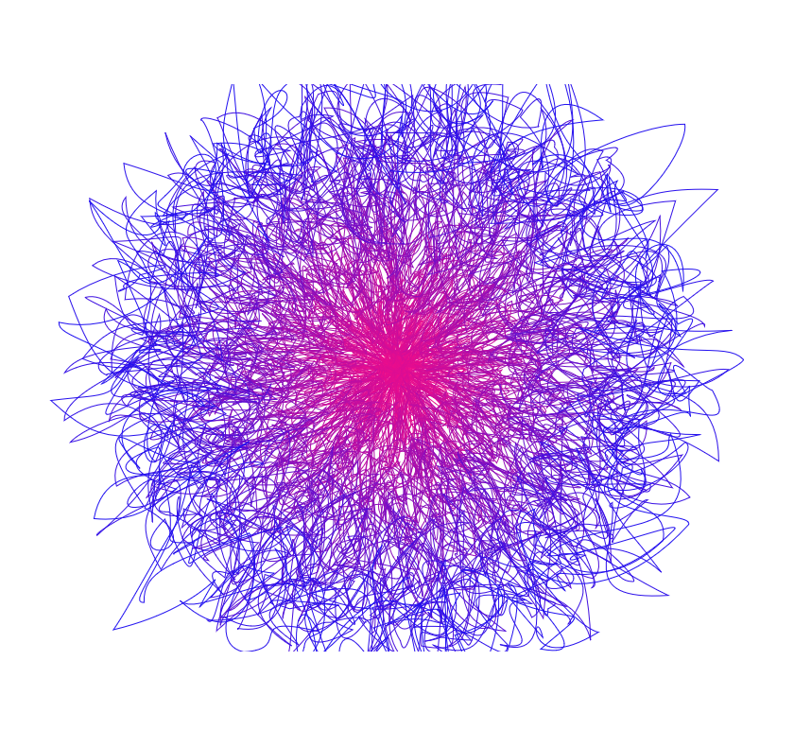





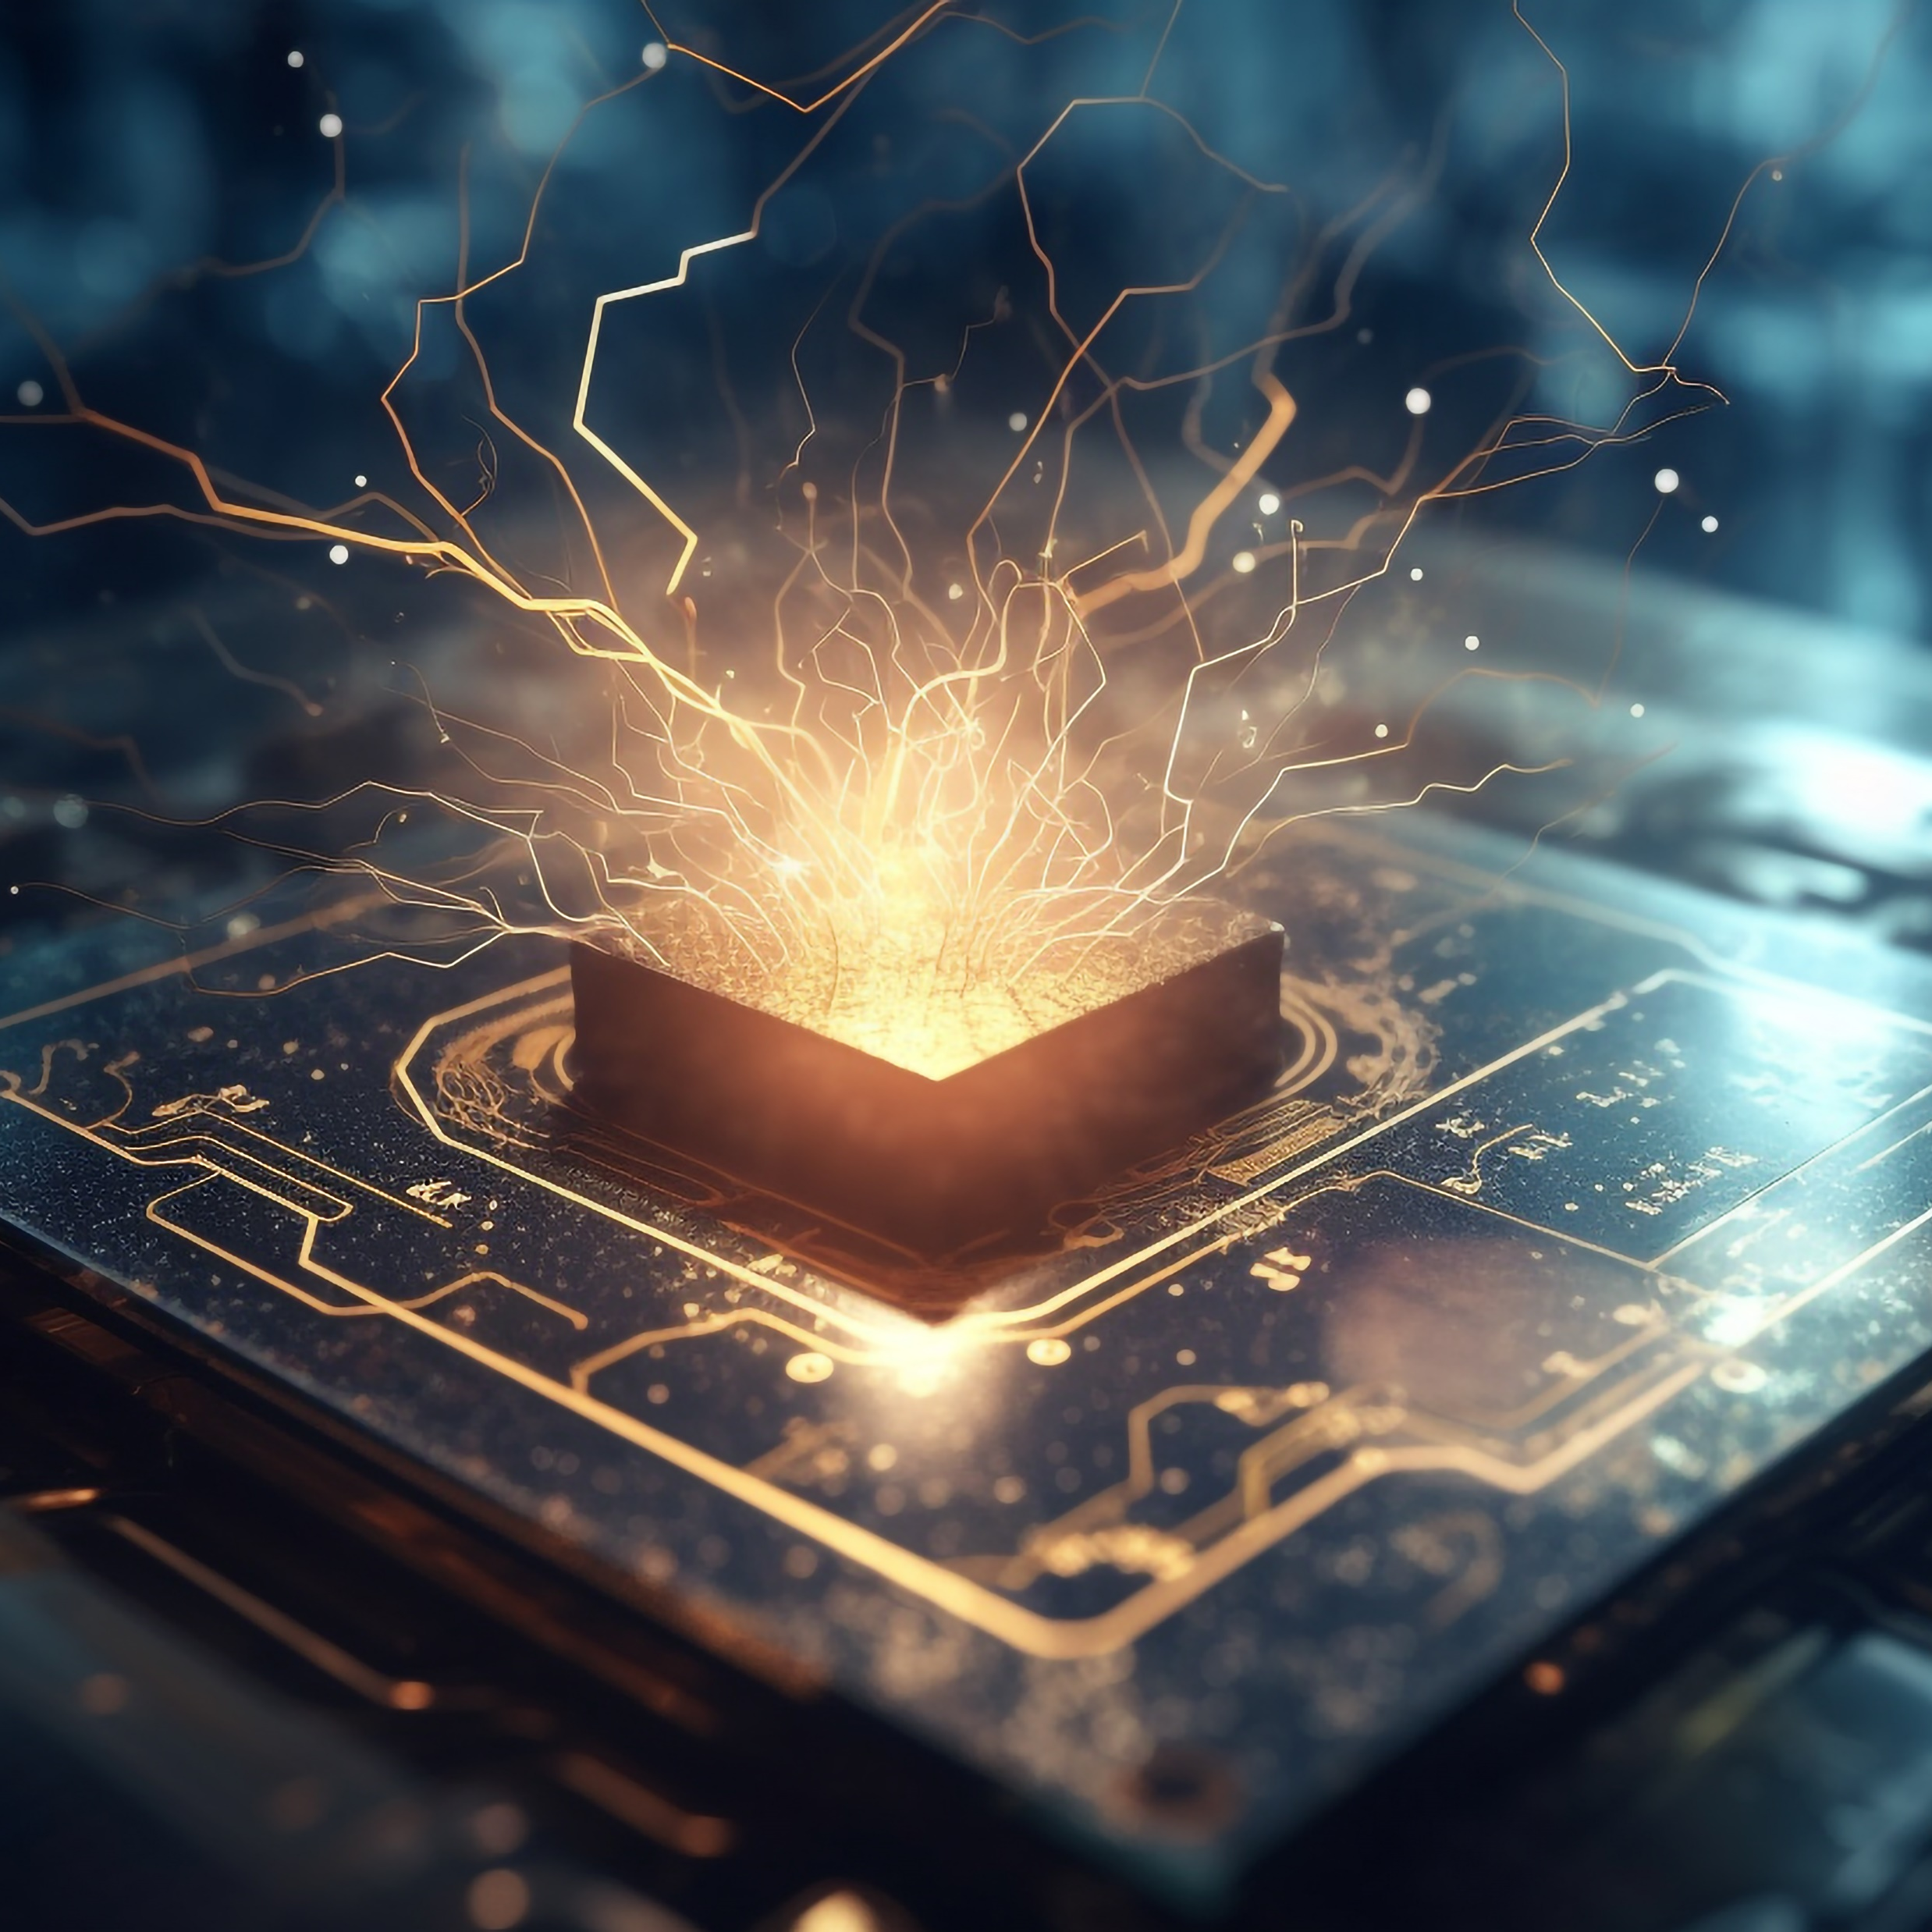

APPLICATIONS OF QUANTUM COMPUTING
Machine Learning and AI
Environmental Impact
Traffic and Transportation
Cryptography and Security
Optimization Problems

Slide 7


Three types of Quantum computing
Quantum computing encompasses several different types of technologies and platforms that leverage the principles of quantum mechanics to perform computational tasks. Here are some of the main types of quantum computing:
Superconducting Qubits
Trapped Ion Quantum
Computers
Topological Qubits
Superconducting qubits are one of the most widely used types of qubits in quantum computing. They are tiny circuits made from superconducting materials that can carry electrical current
Trapped ion quantum computers use ions (usually trapped in electromagnetic fields) as qubits. These qubits are manipulated using lasers. Companies like Ion and Honeywell are actively working.
Topological qubits are a relatively new approach to quantum computing. They are based on the concept of topological quantum states that are highly robust against errors.
1
2
3

Slide 8


Quantum Computing in Industry
Quantum computing has the potential to revolutionize various industries by offering the capability to solve complex problems much faster than classical computers.
FINANCE AND RISK ANALYSIS
Pharmaceuticals and
Drug Discovery
SUPPLY CHAIN AND LOGISTICS
Quantum computing optimizes portfolios pricing derivatives, enabling risk assessment.
Quantum algorithms streamline route planning, inventory management, and demand forecasting for cost savings.
Quantum simulations accelerate drug discovery by modeling molecular interactions..

Slide 9

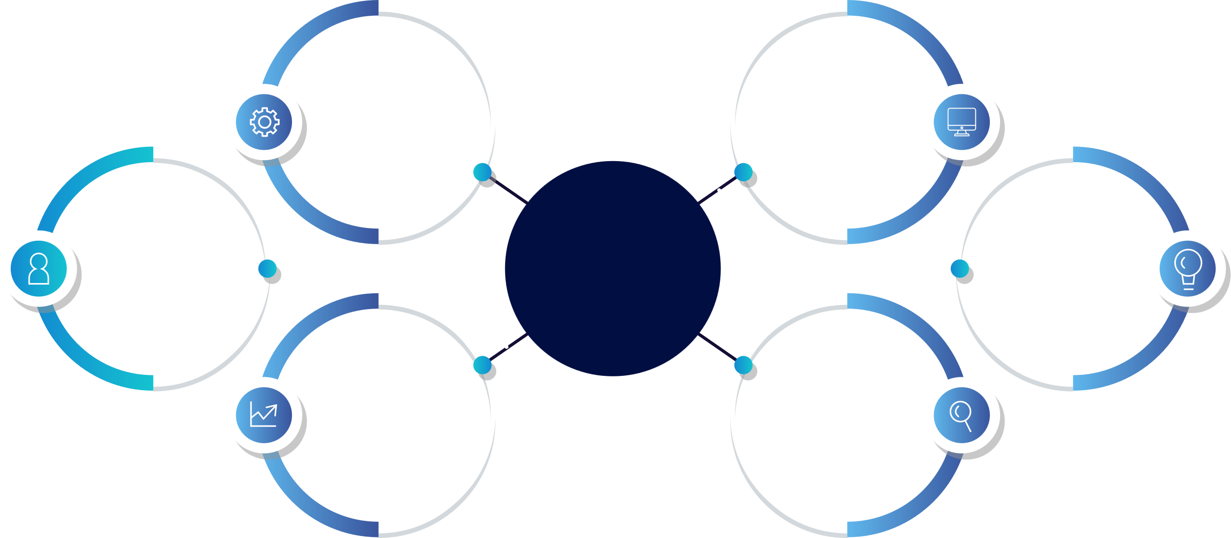
How do Quantum Computers work
Superposition
Quantum Gates
Quantum
Computers
Quantum
Algorithms
Entanglement
Quantum Gates
Measurement

Slide 10


Quantum Computing vs. Classical Computing
Quantum Computing
Classical Computing
Uses qubits that can exist in a superposition of states, representing both 0 and 1 simultaneously.
Utilizes quantum gates to manipulate qubits, exploiting superposition and entanglement properties.
Leverages superposition, allowing qubits to represent multiple states simultaneously.
Qubits can become entangled, where the state of one qubit depends on the state of another, even when separated.
Uses classical bits (0 or 1) as the fundamental unit of information.
Operates on classical bits using logic gates that manipulate bits based on Boolean logic.
Does not have a superposition property; each bit is in either state 0 or 1.
Classical bits are independent and not entangled with each other.

Slide 11
What are the applications of quantum computing ?
Simulation
1
The quantum computer is able to crunch enormous data, which includes molecular activity in one being. This ability enables the computer to create very accurate simulations of real life events, such as photosynthesis.
Optimization
2
Instead of calculating a problem at a time, this computing approach solves various probabilities. Through such a system, you can see how each option can provide the most advantages. Thus, you can optimize that option
Cryptography
3
Cryptography involves difficult mathematical problems such as discrete algorithms and integer factorization. These problems take a long time to solve. However, a computer with quantum principles can do it quickly
Data search
4
Although the conventional computer has evolved so much over the past decades, data search still takes too long sometimes. Quantum principles are capable of speeding up this data search process, especially if the search is unstructured.

Slide 12

advantages of quantum computing?
It speeds up data processing time
solving optimization problems
It can crunch a large amount of data
It is more money efficient in the long run
used to simulate quantum systems

Slide 13
quantum computing tools
Cirq
Qiskit
Quantum simulators
Google's Cirq is an open-source quantum programming framework that provides tools for creating, editing, and running quantum circuits. It's designed for use with Google's quantum processors.
Developed by IBM, Qiskit is an open-source quantum computing framework that allows you to create and run quantum circuits, access quantum hardware, and develop quantum algorithms.
Various quantum simulators are available for simulating quantum circuits on classical hardware. These include the simulators included in Qiskit and Cirq, as standalone tools like the Quantum Development Kit from Microsoft.

Slide 14
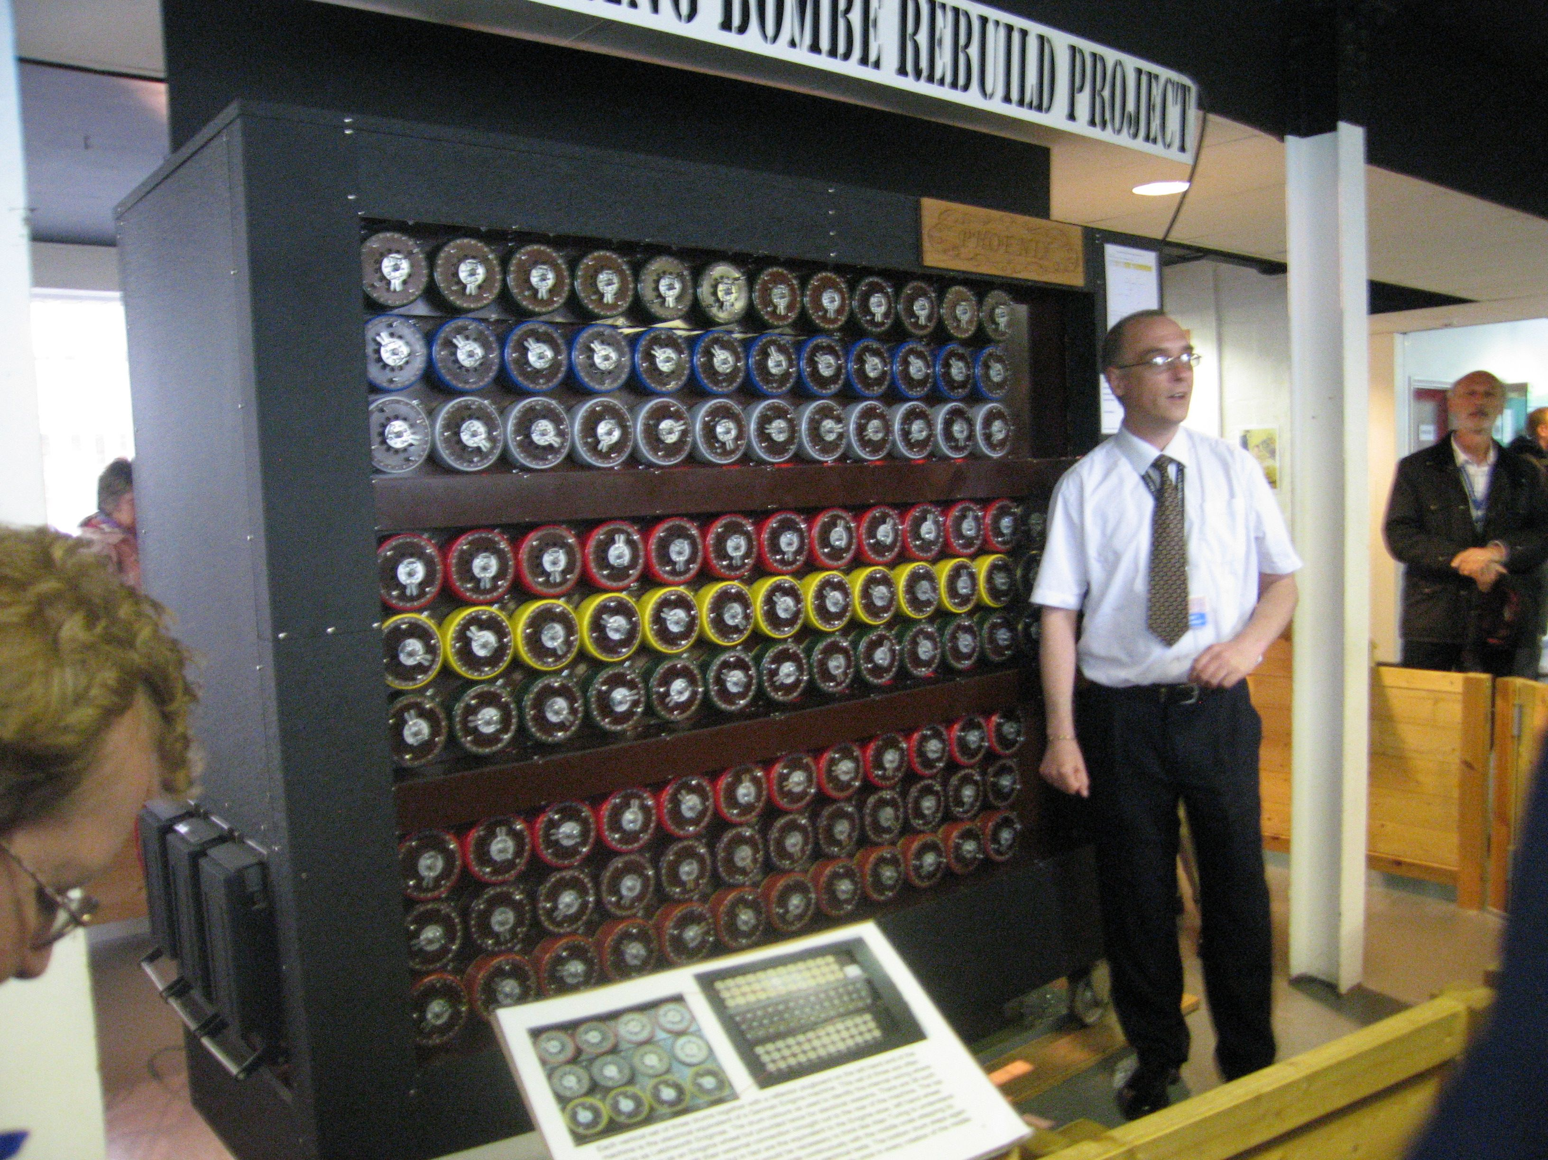
Turing machine

Slide 15
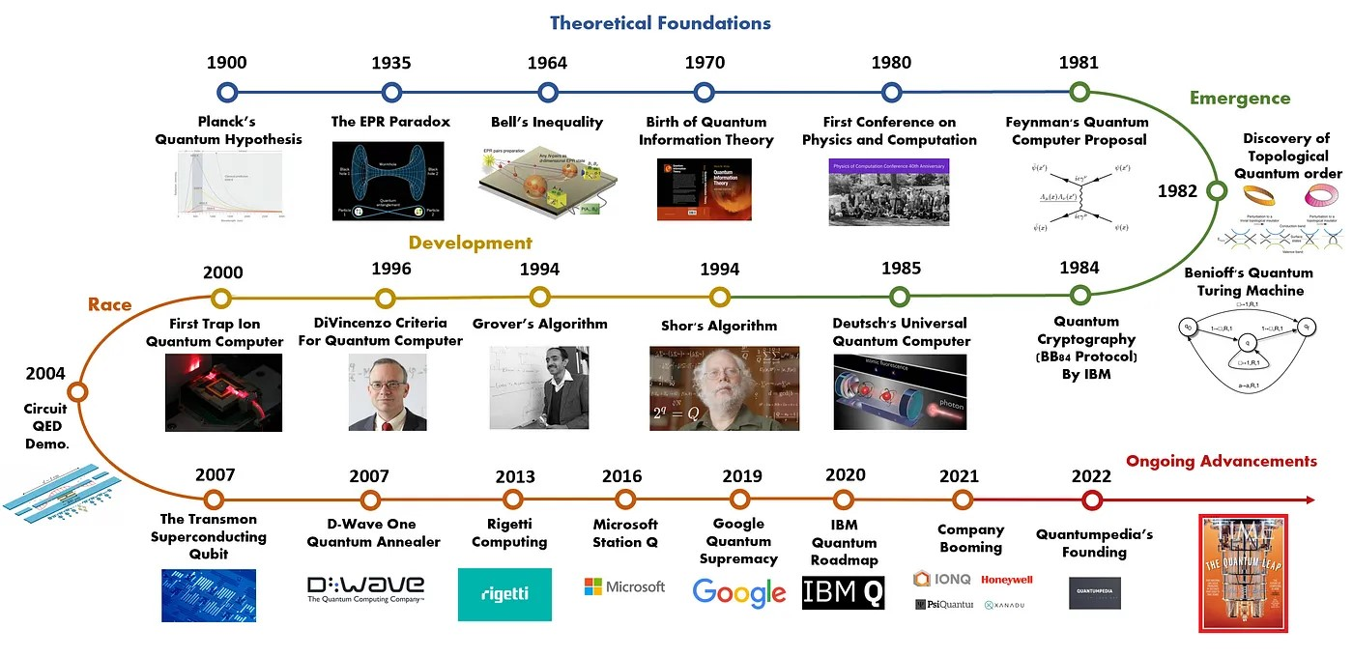

Slide 16
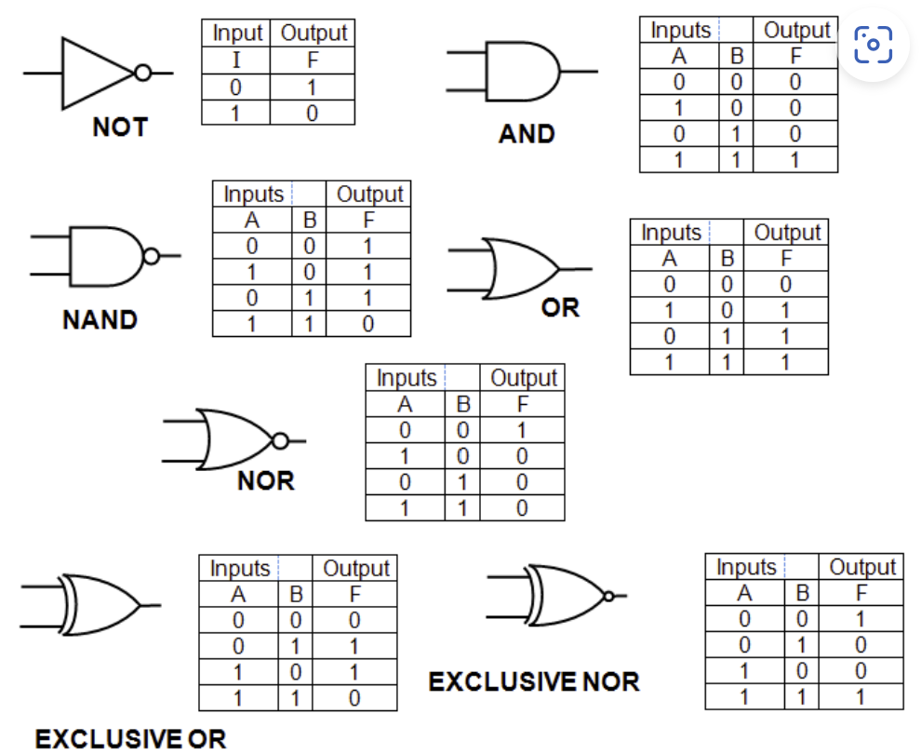
Logic gates

Slide 17
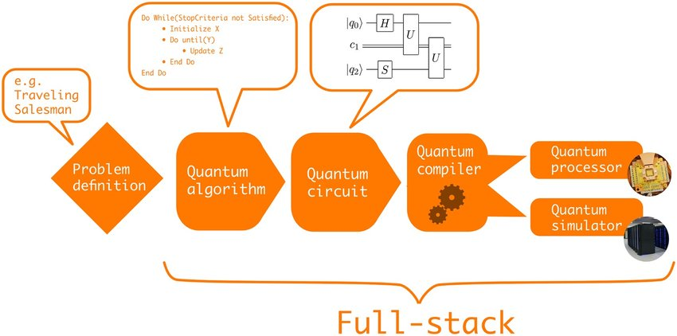
Gates Model Quantum Computation

Slide 18
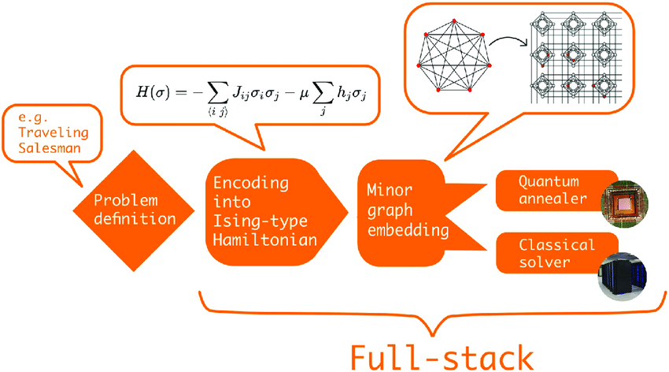
Adiabatic Model Quantum Computation

Slide 19
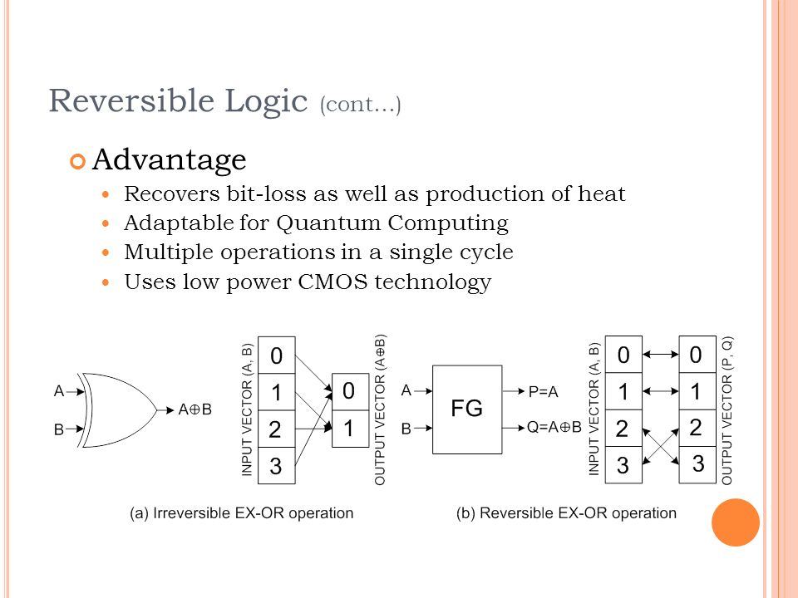
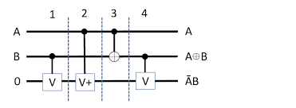

Slide 20
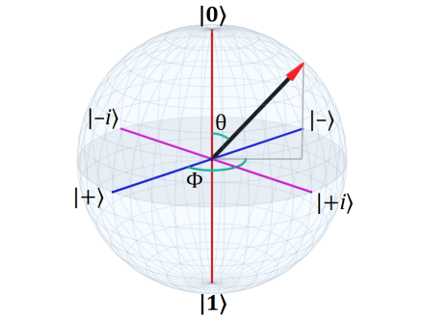
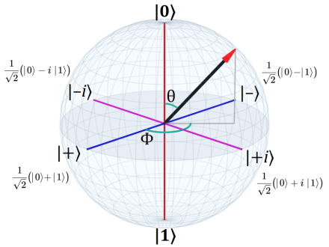
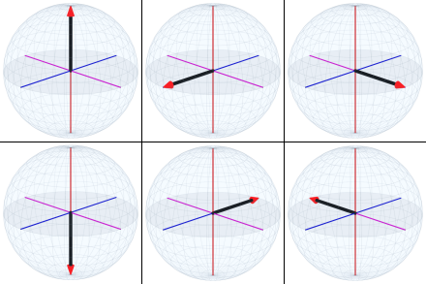
Bloch Sphere

Slide 21
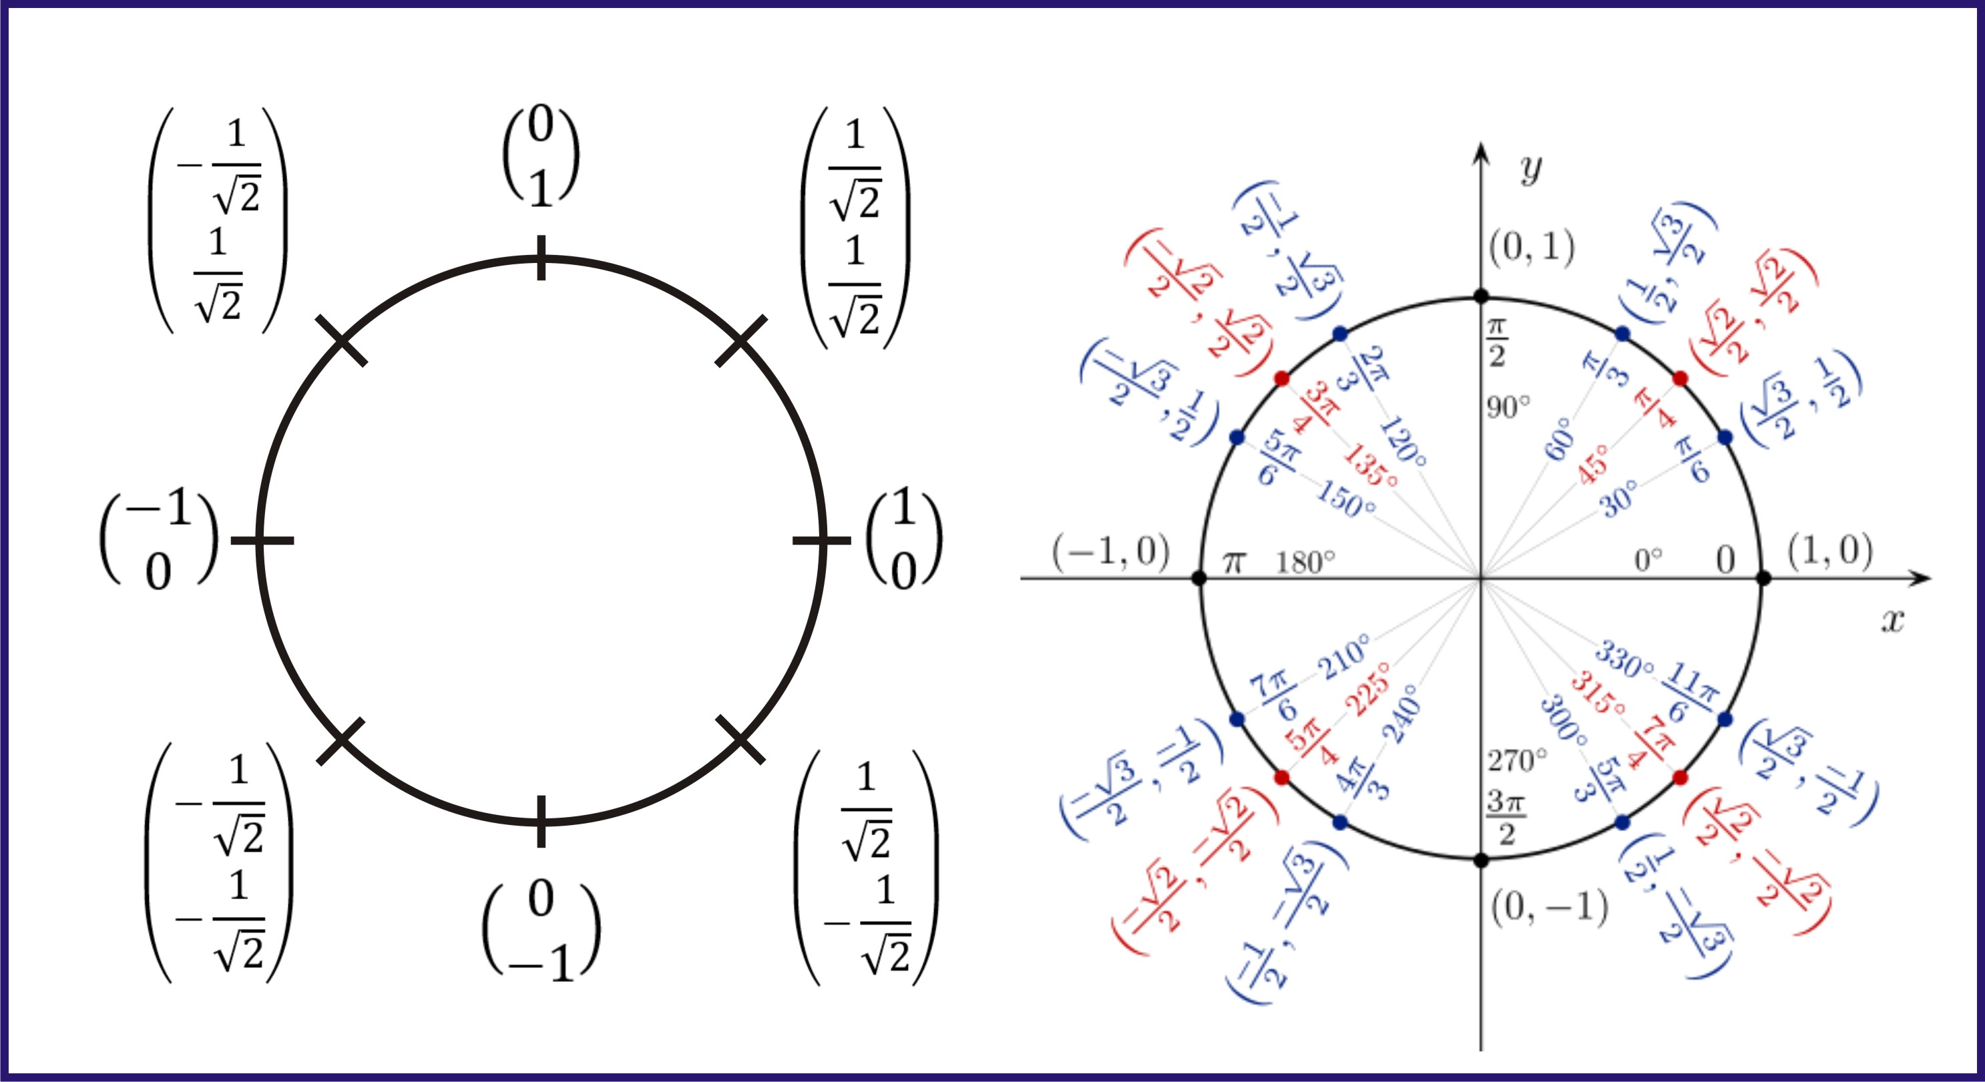
Concept Bloch Sphere for compute Gates

Slide 22
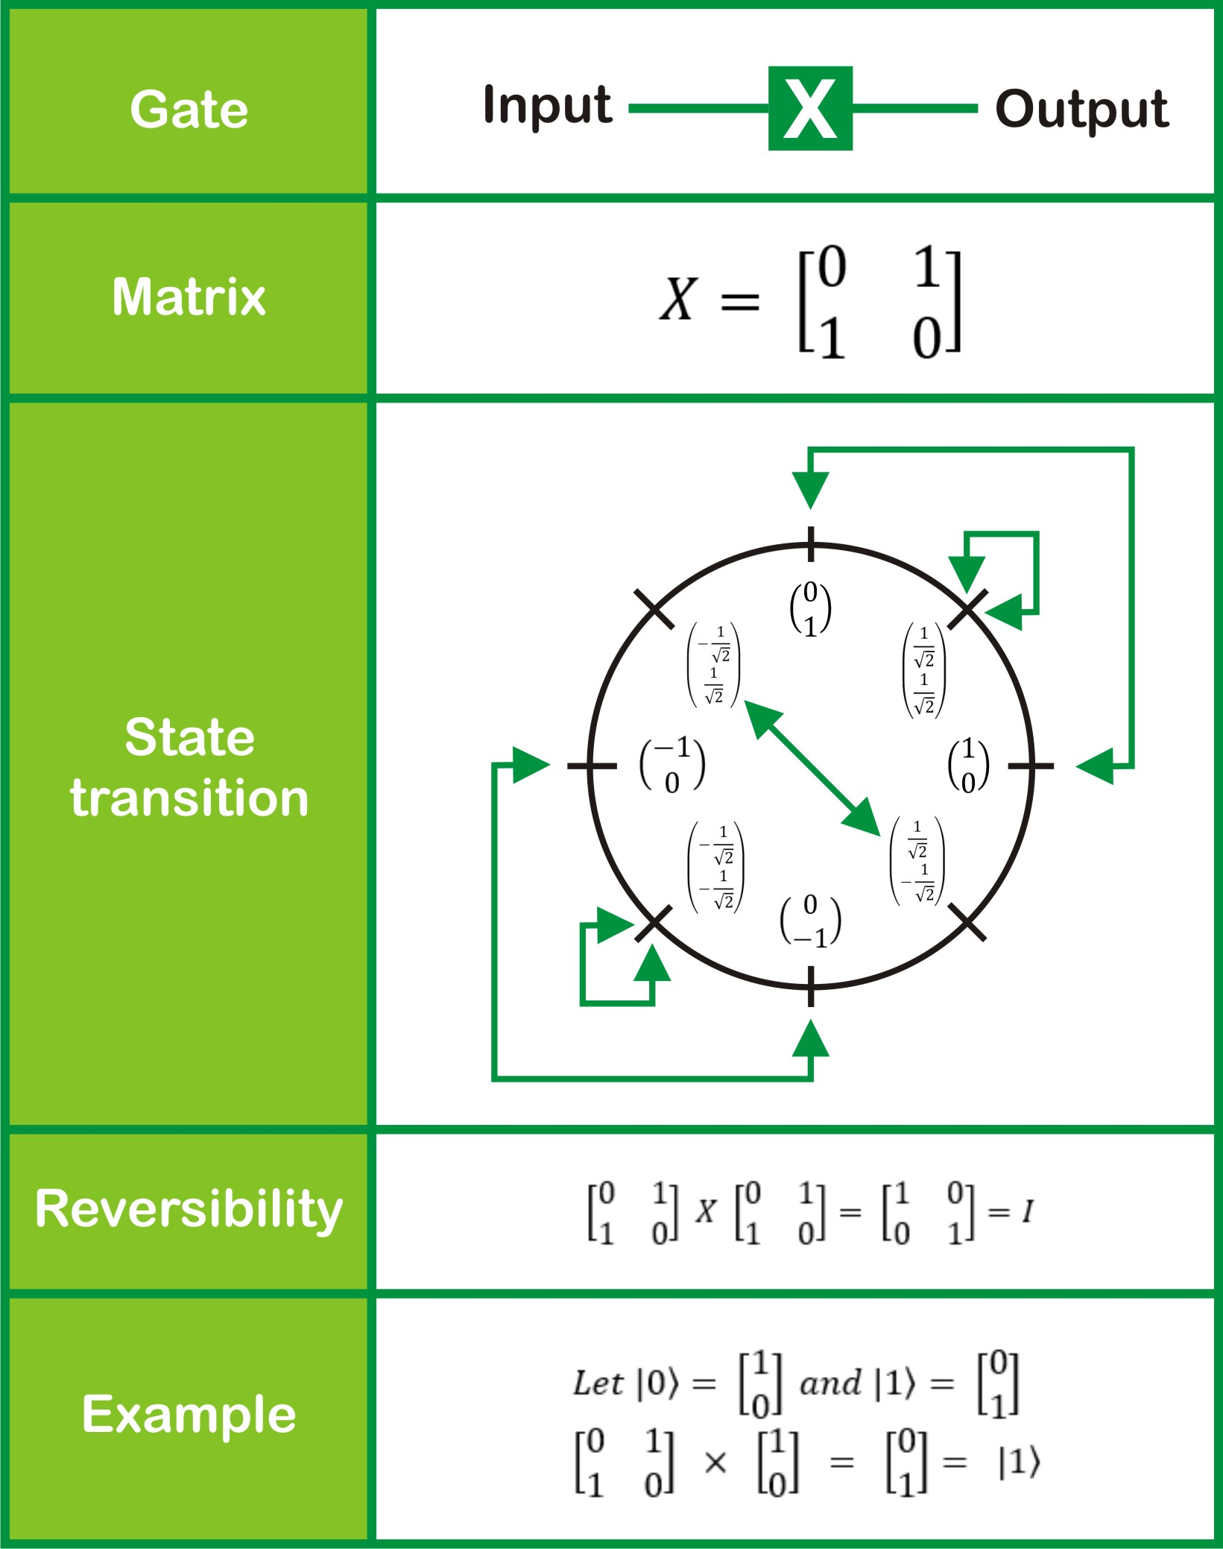
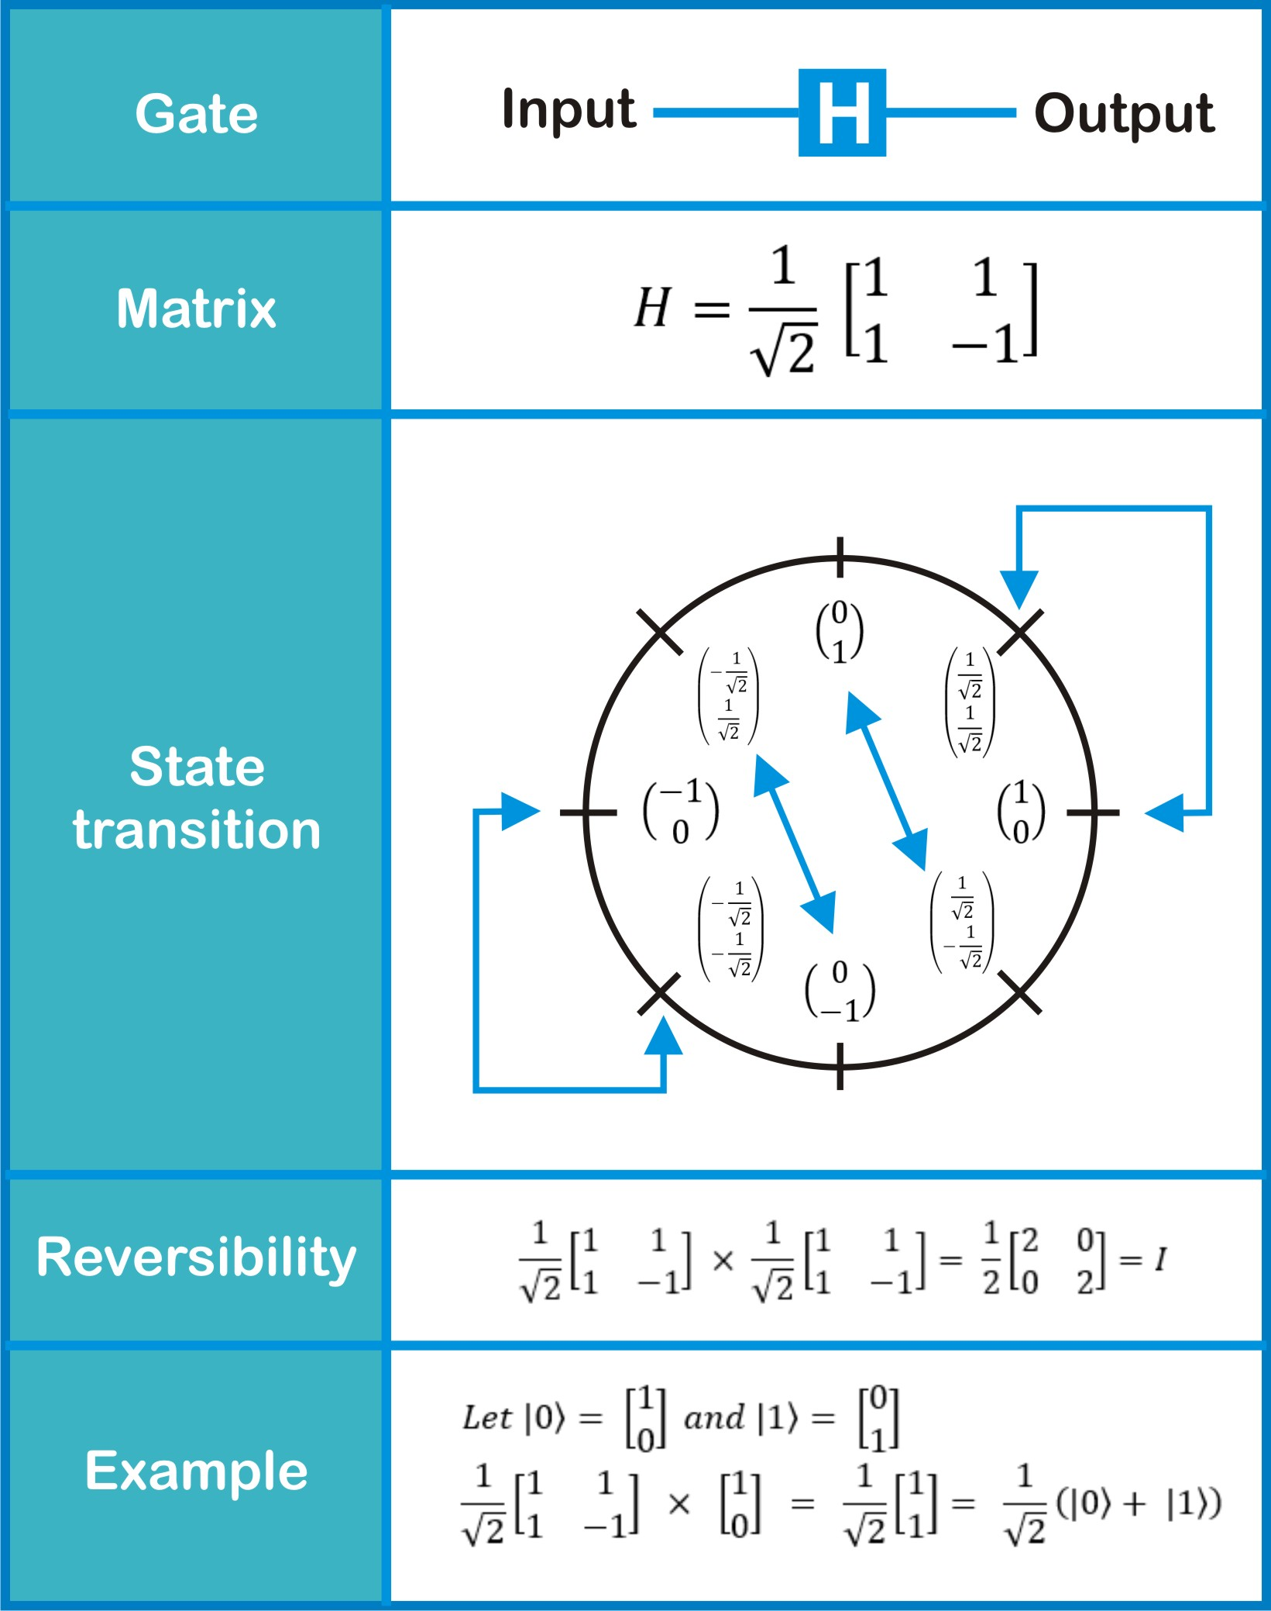

Slide 23
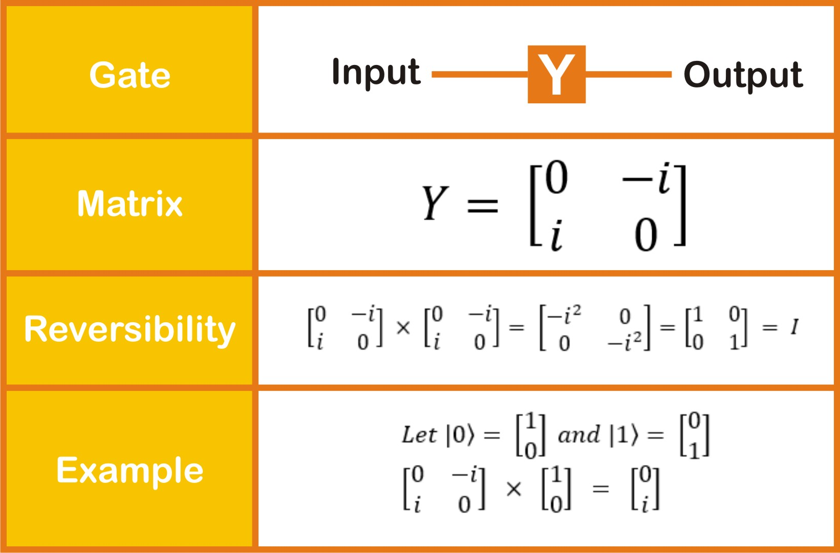
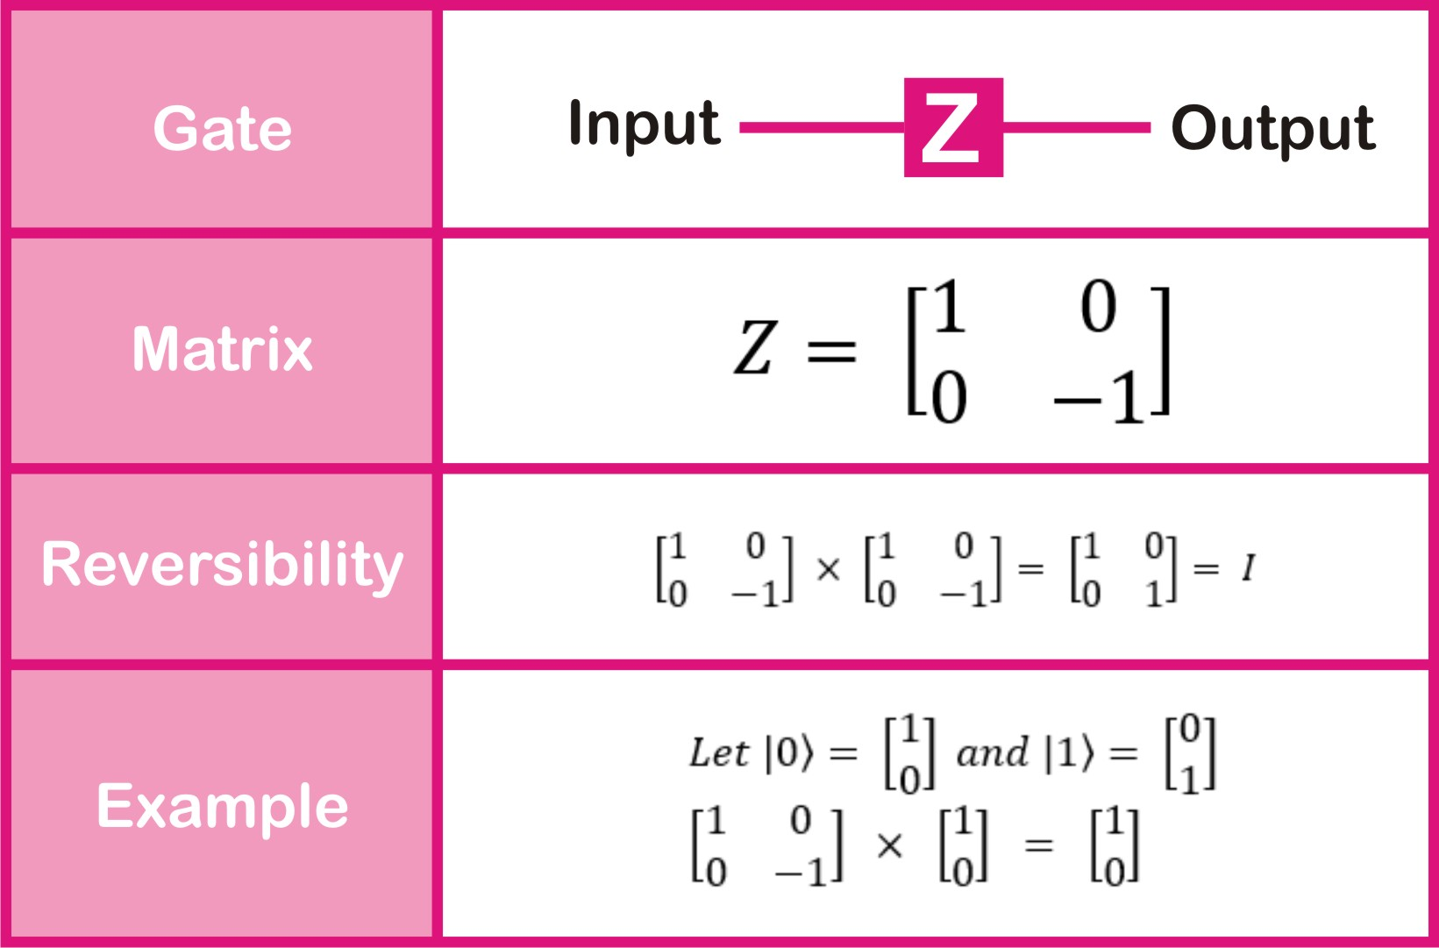
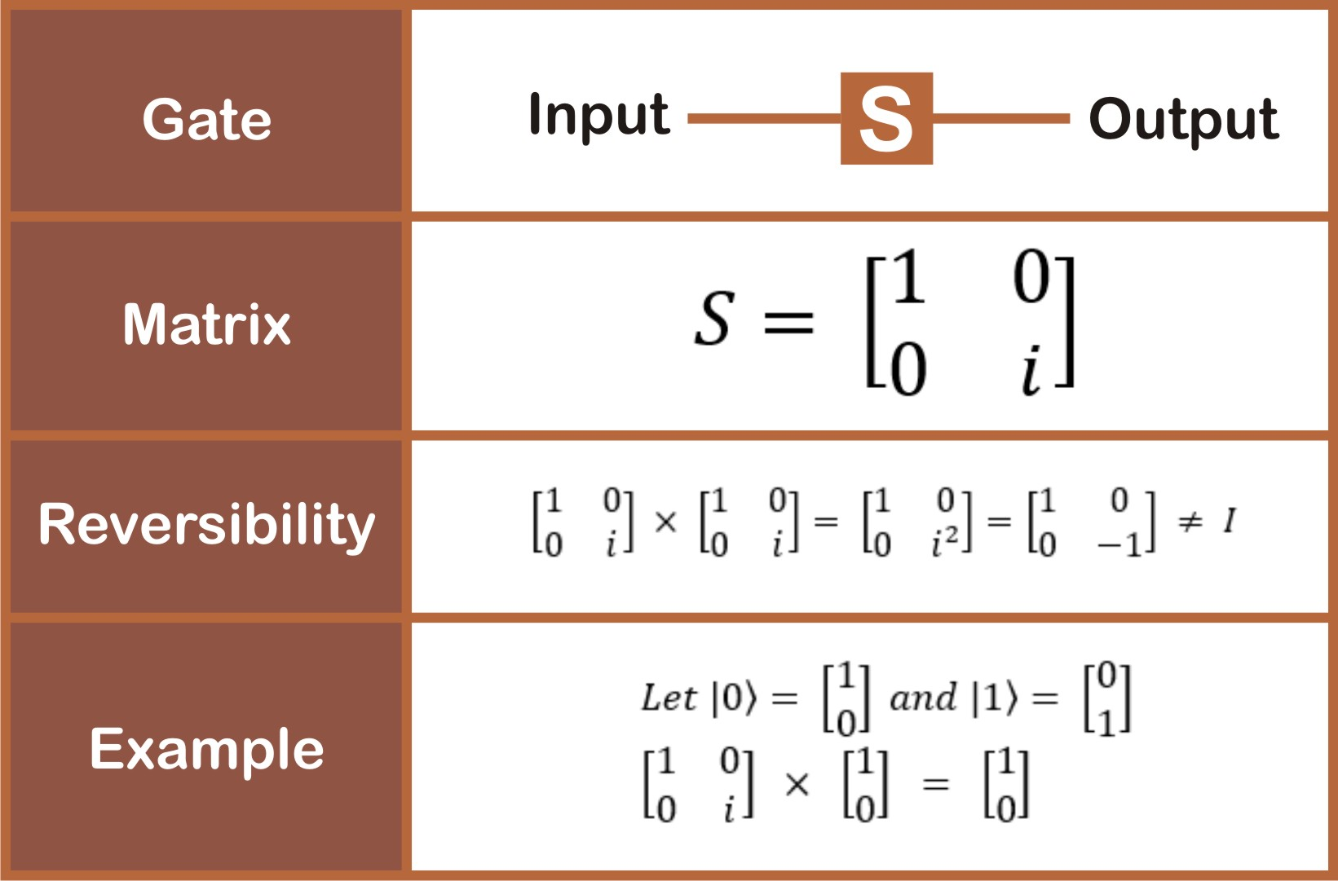
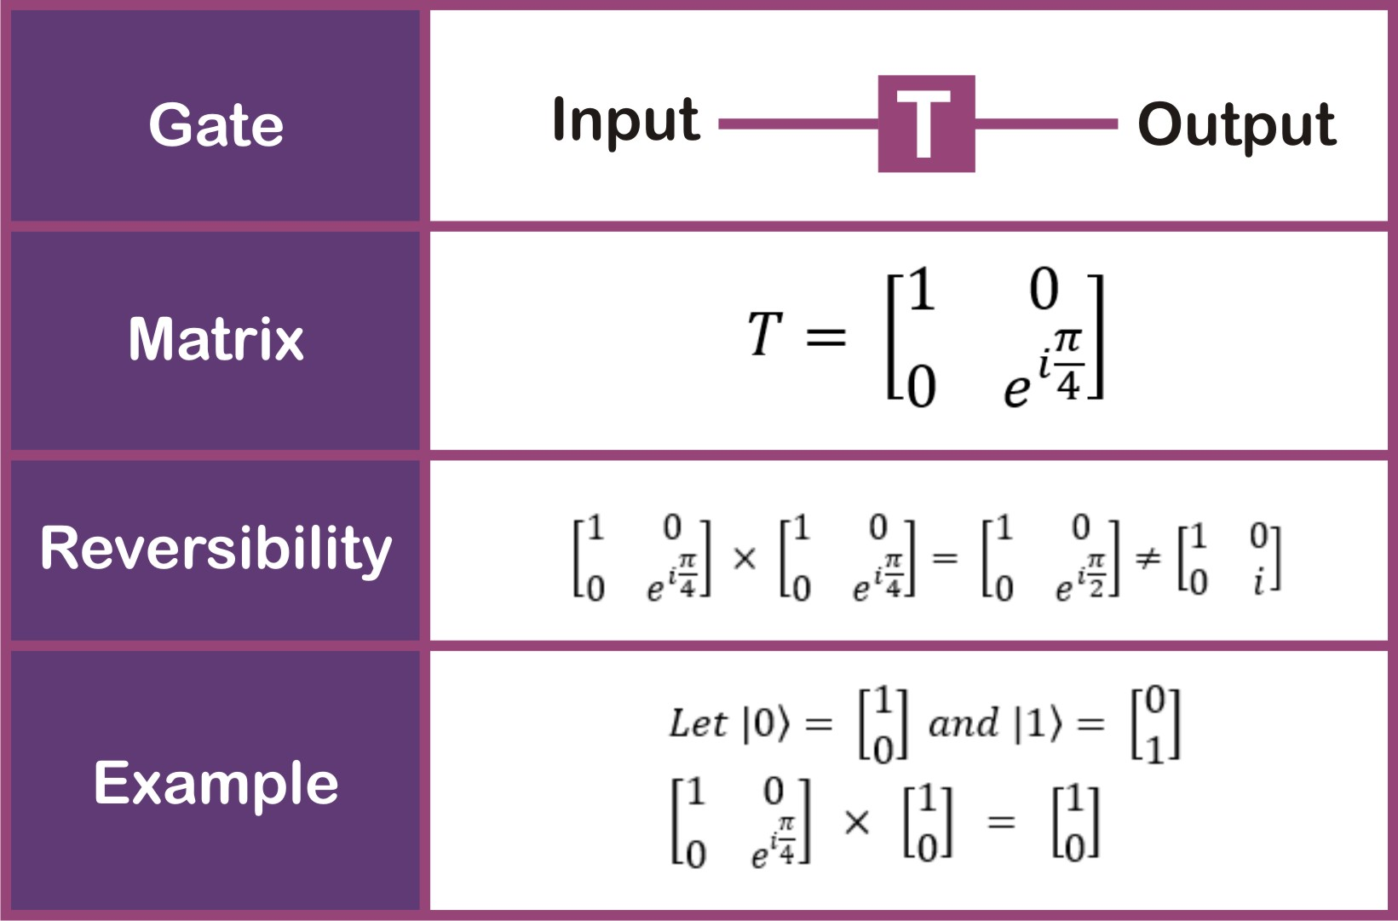

Slide 24
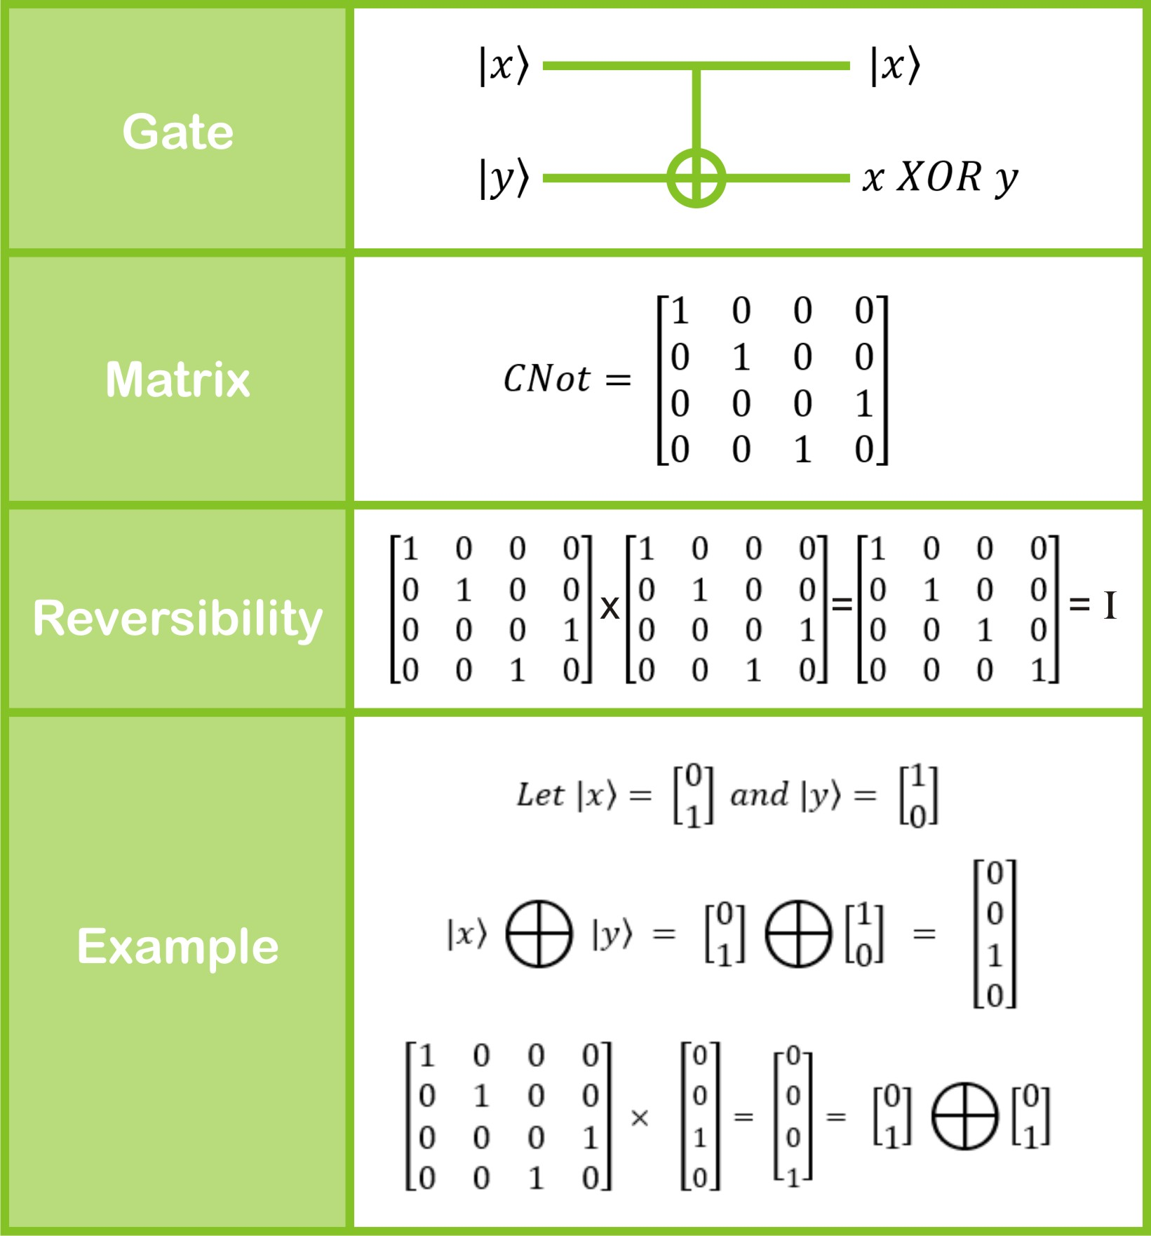
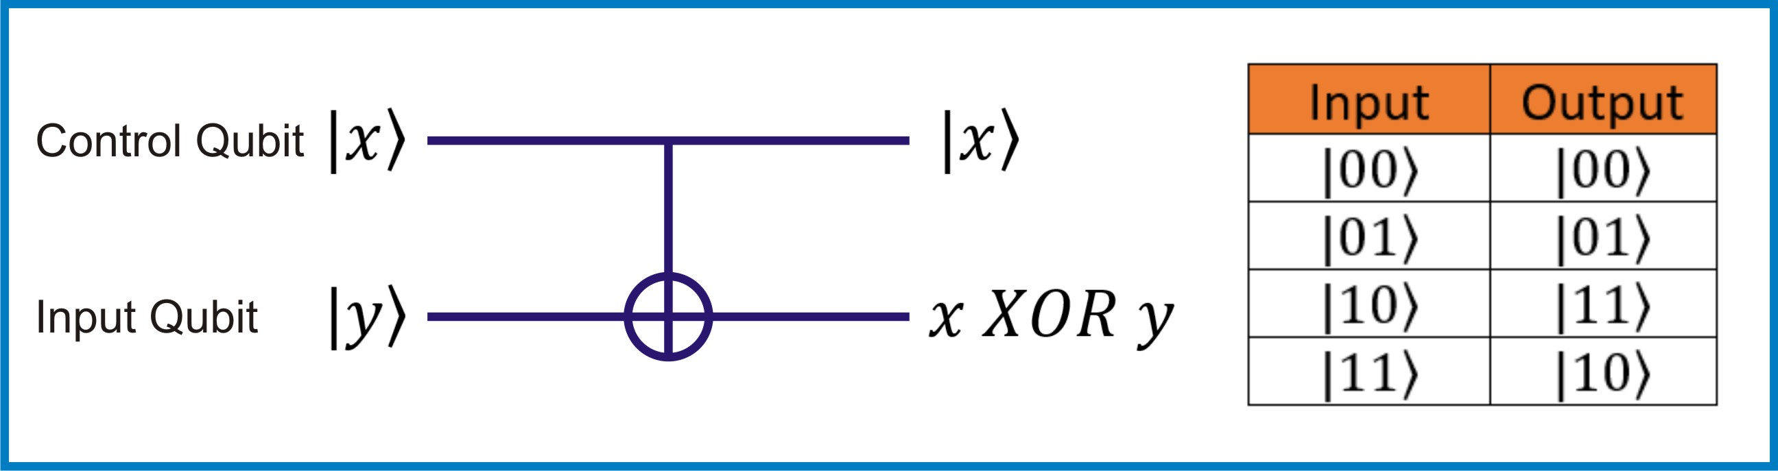
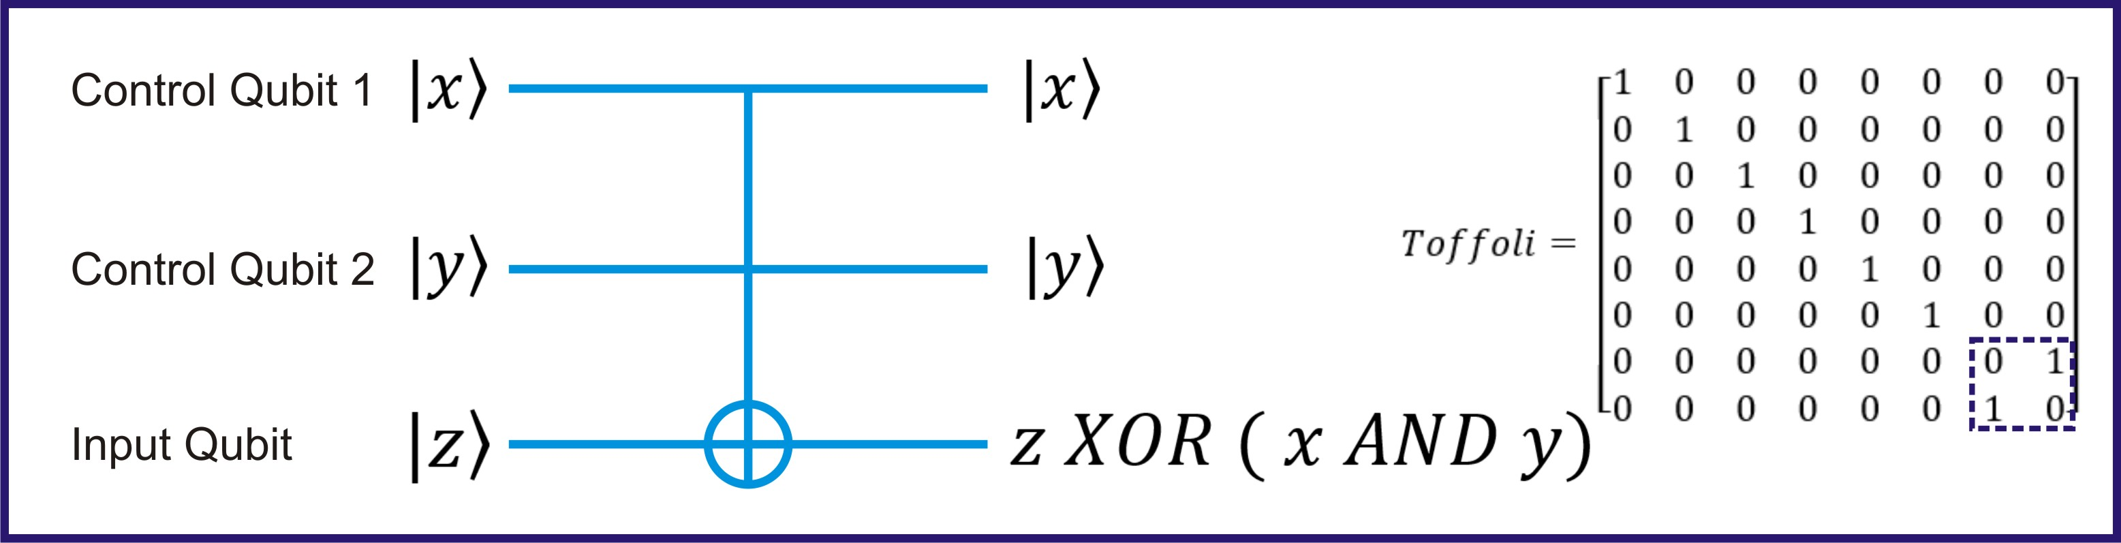

Slide 25
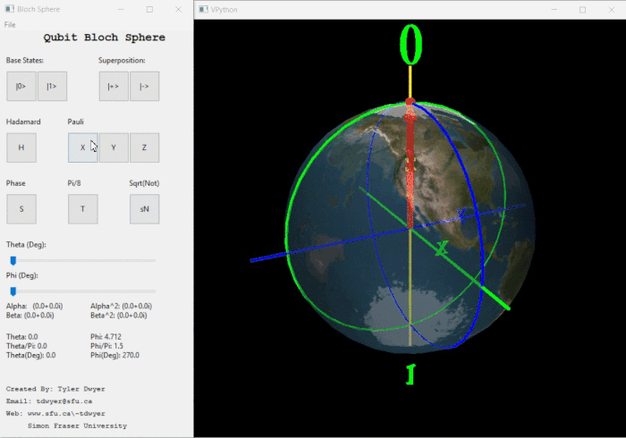
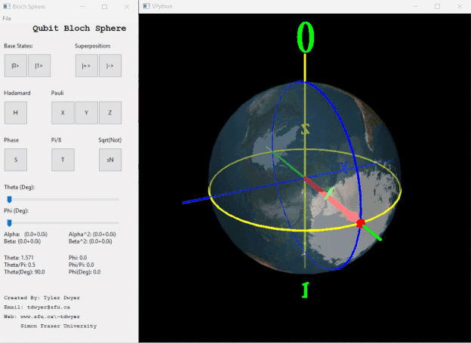
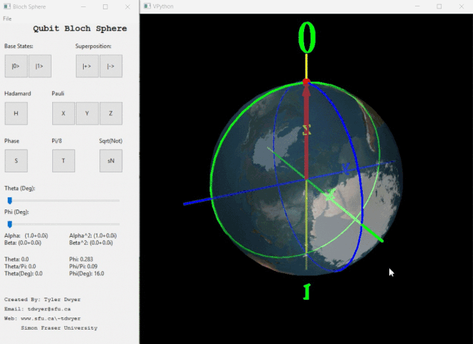

Slide 26
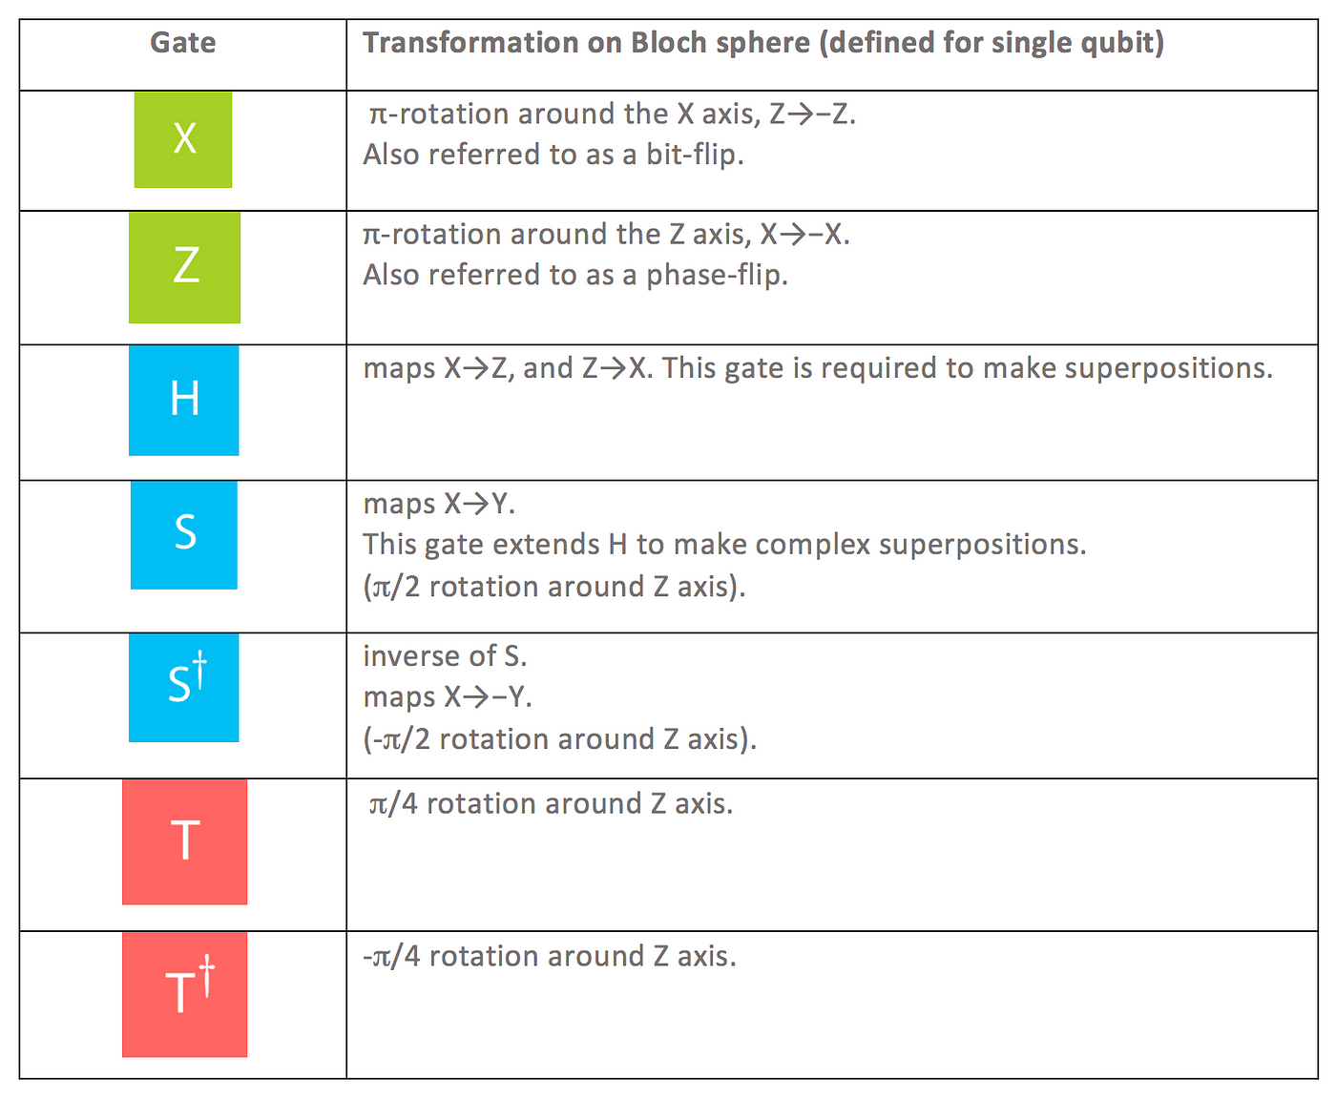
Conclusion of Gates

Slide 27

THANK YOU

